Slide 1
Summarising Is there an Environmental Kuznets Curve for CO2 emissions? A time series analysis on the US Original work by- Rögnvaldur Hannesson
Hannesson, R. Is There a Kuznets Curve for CO₂-Emissions?. Biophys Econ Sust 7, 4 (2022). https://doi.org/10.1007/s41247-022-00099-w
MADE BY :
ASHUTOSH SINGH
2K20/EE/067
DELHI TECHNOLOGICAL UNIVERSITY

Slide 2
ABSTRACT
The history of the environmental Kuznets curve is traced. We estimate how the CO2-intensity of economies is related to GDP per capita and examine the implications for the Kuznets curve. We fnd mixed evidence for the existence of this curve. In many poor and medium rich countries the CO2-intensity has increased since 1990, while in rich countries it has fallen. In some of those it has fallen at an increasing rate, but in others at a declining rate. If the CO2-intensity converges to a lower limit as countries grow richer the Kuznets curve would not exist

Slide 3
Introduction
For more than 30 years, reductions in carbon dioxide (CO2) emissions have been on the world agenda. The Kyoto Protocol set explicit goals for emission reductions, but only for the developed countries. Yet the total emissions of this substance have continued unabated, as Fig. 1 shows. The reason could be that economic growth in developing countries is relatively energy-intensive and that these countries are still growing out of poverty, some rapidly. The fact that the emission reductions stipulated in the Kyoto Protocol did not apply to developing countries can be seen as an acknowledgement of this, making an allowance for further growth in developing countries. Even if emissions of CO2 are still increasing, they have nevertheless peaked in about half of all countries in our sample (90 out of 183).1 Most of these countries are developed ones. This accords with the environmental Kuznets curve, which predicts that emissions of toxic or other undesirable substances will initially rise with the degree of afuence and then fall. The reason why we still have not seen the world emission curve for CO2 bend downwards could be that too few countries have reached the level of afuence where CO2 emissions begin to fall

Slide 4
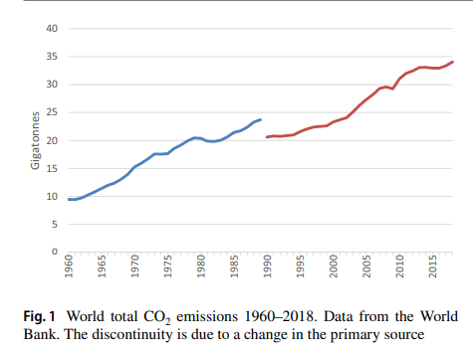

Slide 5
The Origin of the Environmental Kuznets Curve
Kuznets thought it likely that political reasons were behind the increasingly equal distribution of income, manifested in deliberate redistribution through progressive taxation and public consumption. He conjectured that income distribution had been more unequal during the frst phase of industrialization, leading to the hypothesis that the distribution of income would initially become more unequal as economies grew, a development that would be reversed as they grew further and political forces for redistribution became stronger. But he also thought that migration of labor from rural to urban areas could potentially explain the growing equalization of income and devoted a sizeable part of his presentation to numerical examples of rural and urban income distribution to show why this might happen.

Slide 6
What, then, about the environmental Kuznets curve? Do the two Kuznets curves have anything other in common than the inverted U-shape? The environmental Kuznets curve postulates that the emissions of some undesirable substances (wastes such as sulfur dioxide and carbon dioxide emitted into the air, wastes of various kinds emitted into water bodies or dumped on or into the ground) frst increase with economic growth and then fall. The mechanisms behind the original Kuznets curve and the environmental one may be somewhat similar. Public intolerance towards income inequality could lead to increasingly strong policies to counteract unequal income distribution, although it is unclear why this should set in after a certain period of increased inequality has been accompanied by a rising income per capita and be maintained thereafter. In fact, over the last two or three decades, this postulated relationship has been contradicted by a rising income inequality as income per capita has continued to grow (Piketty 2014). As to emission of waste products, it has been argued that people accept this in the initial phase of economic development as its inevitable by-product, but become less and less willing to tolerate it as income and the standard of living rise; as basic needs such as for food and shelter are satisfed, people turn their attention to other, one could say less basic, components of their well being.

Slide 7
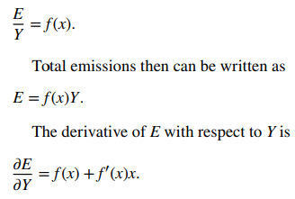
CO2‑Intensity and the Environmental Kuznets Curve
An environmental Kuznets curve for CO2 implies a relationship between emissions (E) and GDP (Y) such that emissions initially rise with the level of afuence and then fall as countries grow richer beyond a certain level. Afuence is most easily measured by GDP per capita (x). Let emissions as a fraction of GDP depend on GDP per capita:

Slide 8

If there is an environmental Kuznets curve for CO2 emissions, E Y > 0 initially and then turns negative as Y grows beyond a certain level. This requires that the CO2-intensity falls as GDP per capita increases []. In the following we examine the development of CO2-intensity and E∕Y. If f(x) falls at a declining rate, the derivative E Y may eventually change sign again, this time from negative to positive, and emissions would increase with GDP. If, for example, f(x) approaches a constant level, emissions would simply increase linearly with GDP. Suppose, for example, that the CO2-intensity (E/Y) of GDP is E Y = { a − bx + cx^2 for x ≤ x, a − bx + cx^ 2 for x > x.

Slide 9
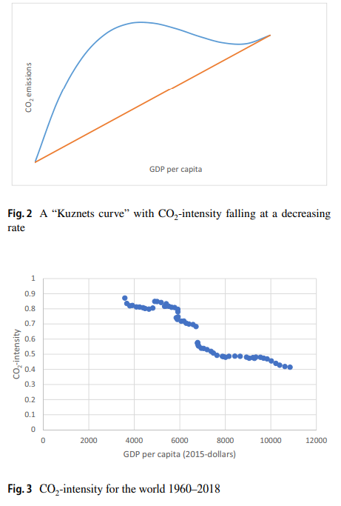

Slide 10
Estimations
The World Bank has calculated CO2-intensity for individual countries for the period 1960–2018, expressed in emissions of kg CO2 per 2015 US dollars. Figure 3 shows the CO2-intensity for the world economy. There is a discontinuity in the data in 1990, as is also evident in Fig. 1. This is due to a change in the primary data source; data from before 1990 are from the Carbon Dioxide Information Analysis Center while data from 1990 onwards are from the World Resources Institute. Linking these two sources is not straightforward; for some countries emissions fell from 1989 to 1990 by as much as 20%, while for others they rose by a similar magnitude. We shall henceforth use the data from 1990 onwards. A further argument for beginning the analysis in 1990 is that no less than 23 countries entered the sample for the frst time that year, mostly countries in the former Soviet Union and its satellites in Eastern Europe. Finally, the awareness of the global warming issue began about 1990; the Rio Environmental Summit was held in 1992, with obvious implications for the envonmental Kuznets curve as it applies to CO2 emissions.
Figure 3 suggests that the CO2-intensity for the world economy has been falling at a declining rate since 1990 and is perhaps converging to a bottom limit. This would be bad news for the Kuznets curve, as already explained. What happens to the global CO2-intensity is the result of decisions taken in individual countries at diferent stages of development and with diferent attitudes to the global warming issue. It is therefore necessary to look at what is happening with CO2-intensity at the individual country level and the implications for the Kuznets curve in each case.

Slide 11
Conclusion
An environmental Kuznets curve for CO2 emissions would ofer an easy way out of the climate change dilemma: just wait for countries to get rich enough, and CO2 emissions will fall. The speed of this process could, however, be a problem: economic development takes time, and until all countries of the world have reached the required level of afuence, much will have been emitted, presumably with long-term efects on climate. The problem could be more serious still: rather than fall uniformly with rising afuence the emissions may only do so for a time and then rise again, because emissions per unit GDP may fall at a declining rate and asymptotically reach a constant level. This, needless to say, makes stronger demands on new technologies if further economic growth is to be reconciled with reductions in CO2 emissions. The falling CO2-intensity in rich countries may exaggerate what happens as the world as a whole gets richer. Rich countries have to a large extent outsourced the production of CO2-intensive goods to developing countries. Allocating CO2 emissions among countries on the basis of consumption rather than production shows that CO2 emissions in rich countries have fallen less, or even increased (Helm 2012). This harks back to a result obtained by Aldy (2005), who found a difference between Kuznets curves for CO2 emissions in individual US states based on income level than those based on production, indicating outsourcing of CO2 intensive processes.

